Slide 1
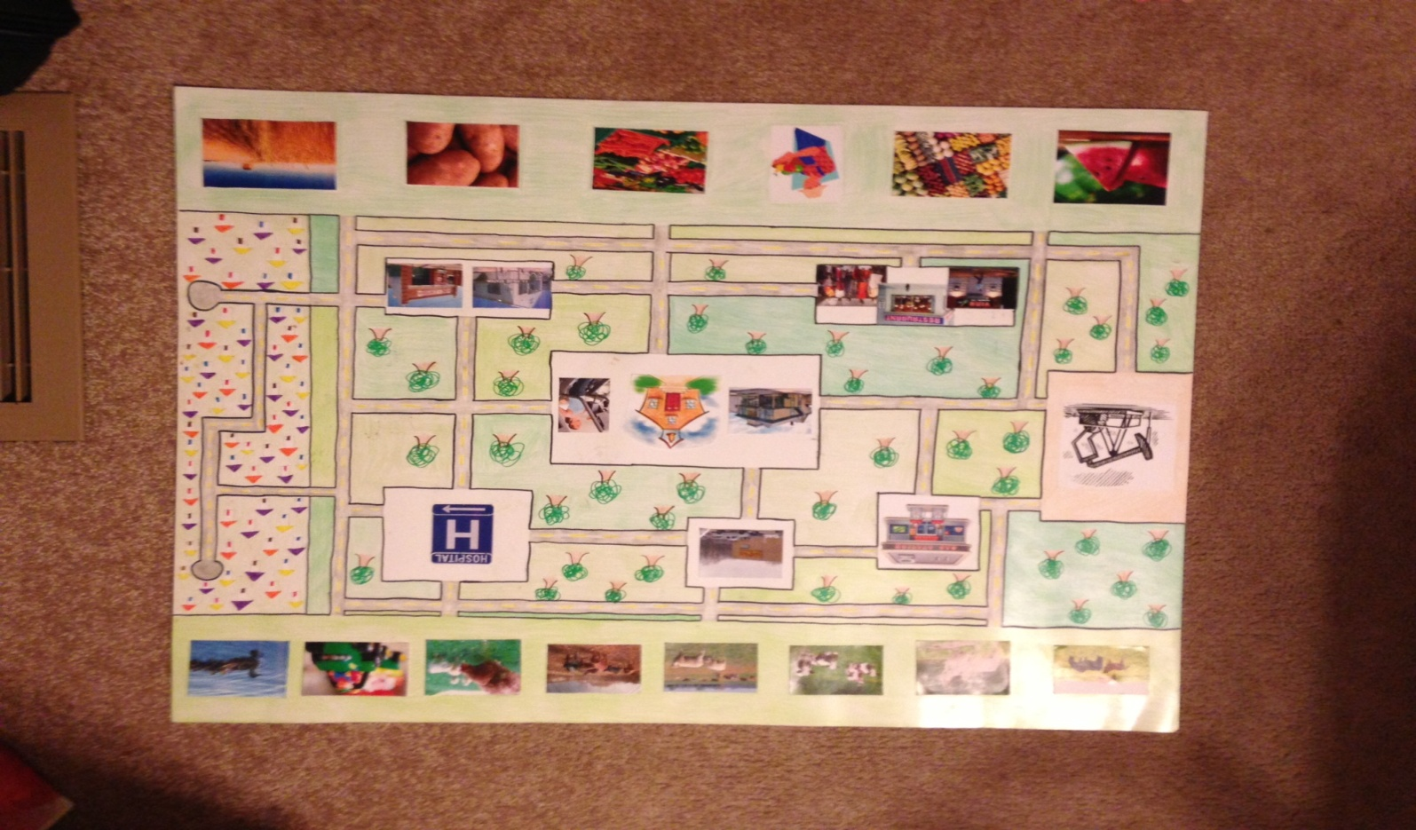
POD
By: Caitlyn Corder, Diana Fast & Trevor Moore

Slide 2
School Philosophy
The school is based on two main theories.
  Situative (Community based, focus is on the importance of community)
  Cognitive (teaching the basics, with older students making connections to previous knowledge learned)
All members of the community collaborate to create a self sustained society.
  Every person goes through the community life cycle.
    Elementary
    Middle
    Trade School
    Apprenticeships
    Career/Mastery
    Retire/Volunteer

Slide 3
Schooling
In the primary grades (k-8) students go to school to gain basic educational skills and to prepare to become an productive member of society.
In grades 9-10 students explore various career paths by volunteering in all aspects of the community.

Slide 4
Apprenticeship
In grades 11-12 students select a career path and begin an apprenticeship with a designated mentor in their selected field.
  In 11th grade you work with your mentor to learn the ground work for the occupation.
  In 12th grade you work along side the professional.

Slide 5
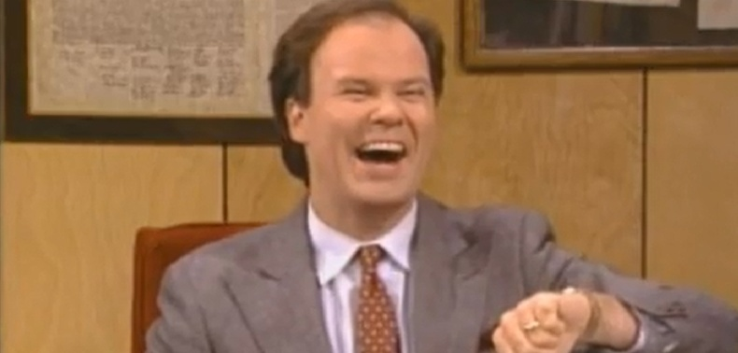
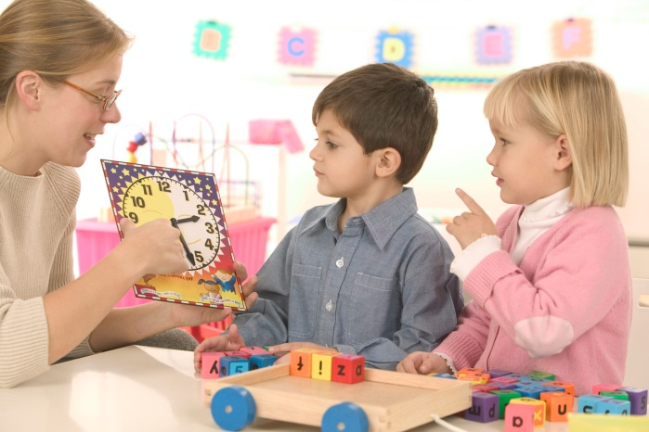

School
Overseen by a principal.
Only for grades k-10
Occupations:
  Teachers
  Librarian
  Janitorial

Slide 6

Store
Overseen by a CEO
Ran by 11-12 grade business students
Occupations:
  Cashiers
  Sales people
  Pharmacist
  Stalkers
  Store Manager

Slide 7



Hospital
Overseen by a Hospital supervisor.
Ran by 11-12 grade medical students.
Occupations:
Nurses
Administration
EMTs
Doctors
Veterinarians

Slide 8
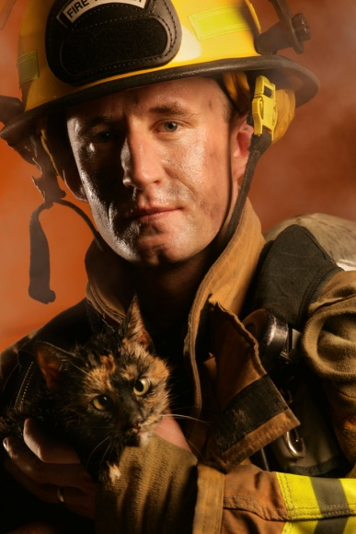
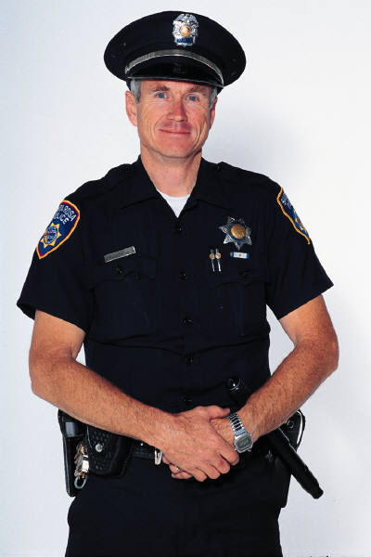
Police/Fire
Overseen by a Police Chief and a Fire Chief.
Ran by 11-12 grade Criminal Justice students and future Firefighters.
Occupations:
  Police officers
  Firefighters
  Dispatchers
  Corrections officer

Slide 9

Designers
Overseen by the Dean of Design.
Ran by 11-12 grade Designer students.
Occupations:
  Sales associates
  Fashion designers
  Home decorators
  Factory workers

Slide 10


Restaurant
Overseen by an owner.
Ran by 11-12 grade Business students.
Occupations:
  Chef
  Waiters/Waitress’
  Busboys

Slide 11



Artists
Overseen by Producers.
Ran by 11-12 grade Art students.
Occupations:
  Painters
  Musicians
  Singers/Song writers

Slide 12

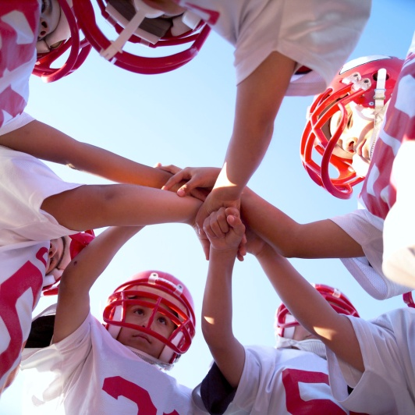
Health and Wellness Center
Overseen by a Health Coordinator.
Ran by 11-12 grade Health students.
Occupations:
  Nutritionist
  Personal Trainers
  Health Advisors
  Activities Instructors
  Physical Therapist
  Safety Monitor

Slide 13
Handy Man
Overseen by a Handy Man.
Ran by 11-12 grade
Occupations:
  Mechanic
  Plumber
  Electrician
  Construction
  Computer Technicians
  Carpenters

Slide 14
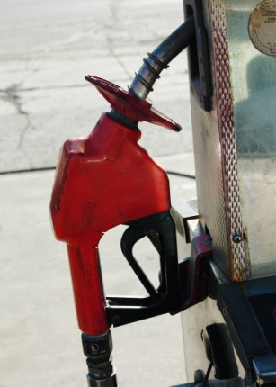
Oil Corporation
Overseen by a manager.
Ran by 11-12 grade science students.
Occupations:
  Transporter
  Extractors
  Oil Plant workers
  Gas station attendants

Slide 15




Produce Farm
Overseen by a Agricultural Specialist.
Ran by 11-12 grade 4-H students.
Occupations:
  Farmers
  Transporters
  Pickers

Slide 16
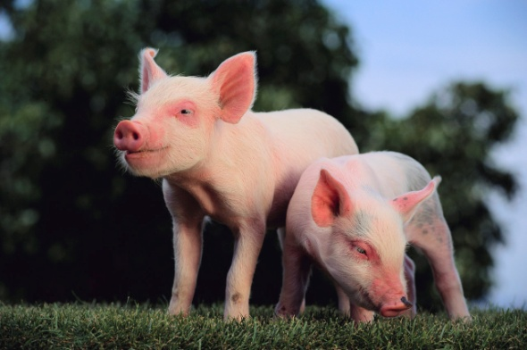
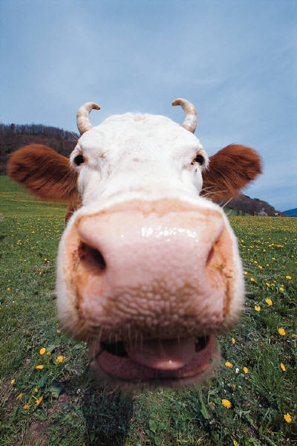
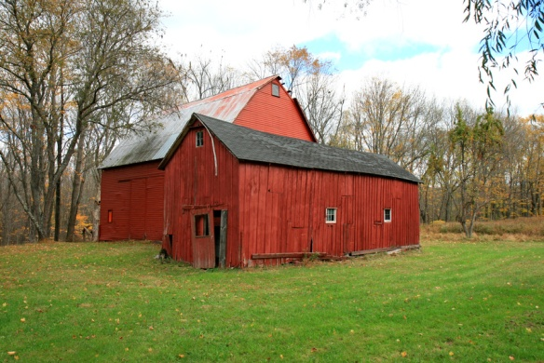
Cattle Ranch
Overseen by a Farmer.
Ran by 11-12 grade 4-H students.
Occupations:
  Farmer
  Slaughterers
  Transporters
  Cowboys

Slide 17
Labor Work
Overseen by professionals from various fields.
Occupations:
  Custodians
  Gas station attendants
  Fruit/Produce Pickers
  Farm workers
  Factory Workers
  Transporter

Slide 18


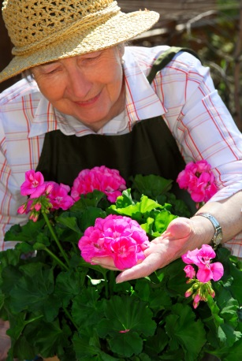
Retirement
After mastering a particular career, adults have the option to either retire or go back to school to become an apprentice again.
If the adult chooses to retire the two options are:
  Volunteer in the Elementary or Middle levels for the school.
  Mentor a(n) apprentice(s)

